Slide 1

AquaPure
BILHA MUTURI, NAIMA HASSAN, PAULINE BROWN

Slide 2
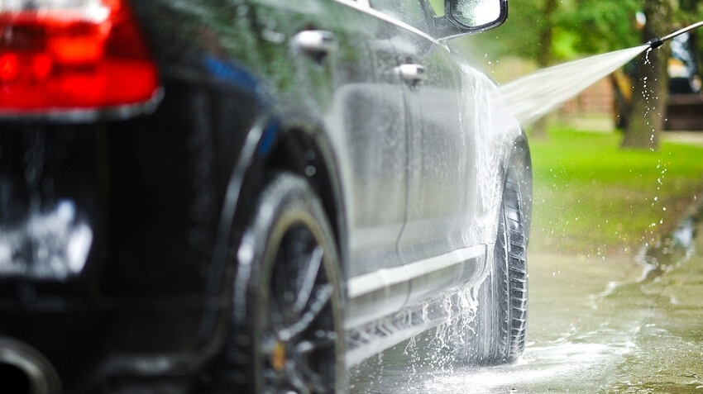
LENDING ONE'S SELF COMPLETELY IN THE MOMENT

Slide 3

USES OF THE RECYCLED WATER
Watering the garden
Flushing the toilet
Washing cars
General cleaning

Slide 4
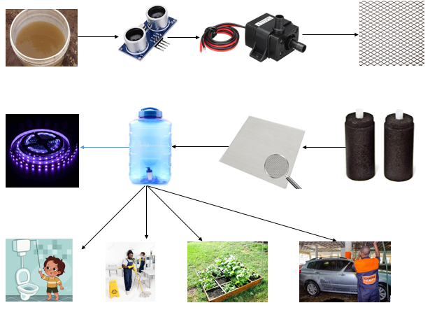

Slide 5
WHY CHOOSE AQUAPURE?
CUSTOMERS' FREEDOM
SAVE
ENVIRONMENT CONSERVATION

Slide 6
EXPECTED CUSTOMER GROWTH
40
30
20
Word of mouth
Website
Flyers
Brochures
Social media
10
0
Month 1
Month 2
Month 3
Month 4
Month 5
Month 6
Month 7
Month 8
Month 9
Month 10
Month 11
Month 12

Slide 7
NEEDED FUNDING
(4 MONTHS)
KSH 2,215,672
KSH 50,000 PER PRODUCT AND FREE INSTALLATION

Slide 8

Value proposition: Trust
Grey water
Zero chemicals
Customer education
Customer freedom

